Slide 1



Consumer Goods Ad-Hoc Insights

Slide 2

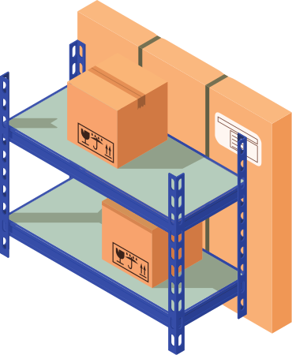
Introduction
Atliq Hardware, a fictional corporation, stands out as a major computer hardware manufacturer in India and has a robust global presence.
Despite its prominence, the management recognizes a need for more timely and informed decisions backed by data insights.

Slide 3
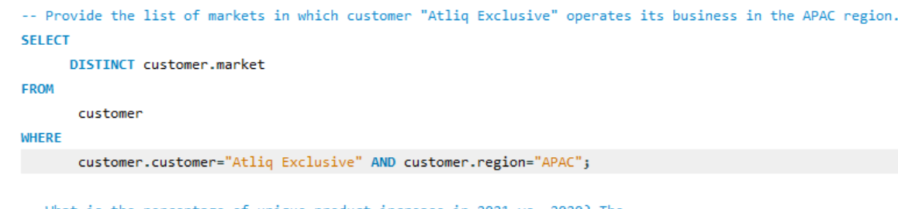
Provide the list of markets in which customer "Atliq Exclusive" operates its
business in the APAC regio

Slide 5
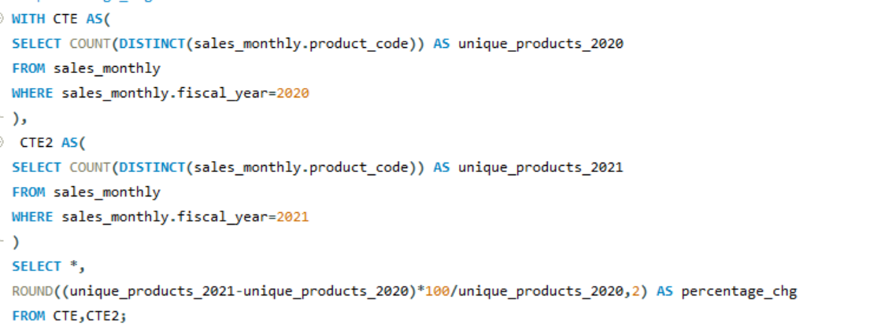
What is the percentage of unique product increase in 2021 vs. 2020? The
final output contains these fields,
unique_products_2020
unique_products_2021
percentage_chg

Slide 7
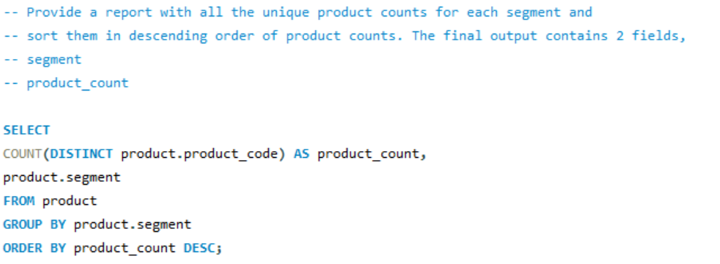
Provide a report with all the unique product counts for each segment and
sort them in descending order of product counts. The final output contains
2 fields,
segment
product_count

Slide 9
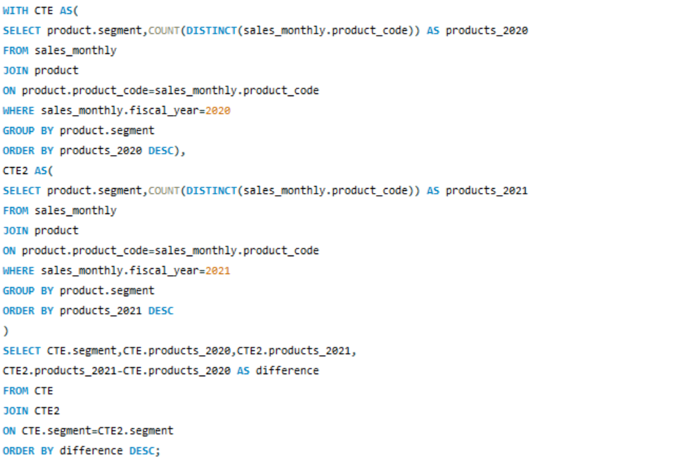
Follow-up: Which segment had the most increase in unique products in
2021 vs 2020? The final output contains these fields,
segment
product_count_2020
product_count_2021
difference

Slide 11
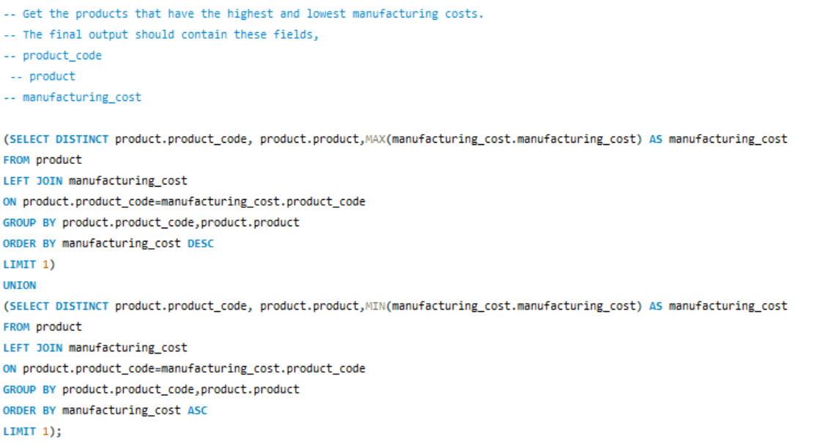
Get the products that have the highest and lowest manufacturing costs.
The final output should contain these fields,
product_code
product
manufacturing_cost

Slide 13
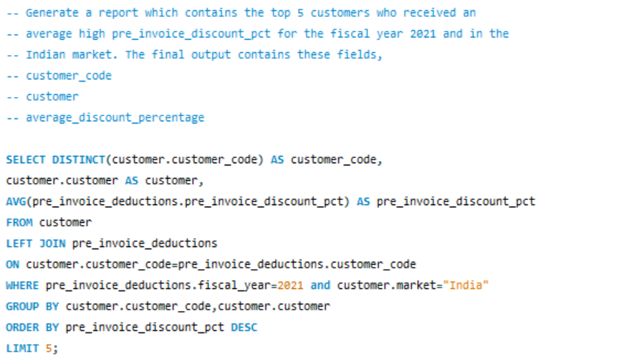
Generate a report which contains the top 5 customers who received an
average high pre_invoice_discount_pct for the fiscal year 2021 and in the
Indian market. The final output contains these fields,
customer_code
customer
average_discount_percentage

Slide 15
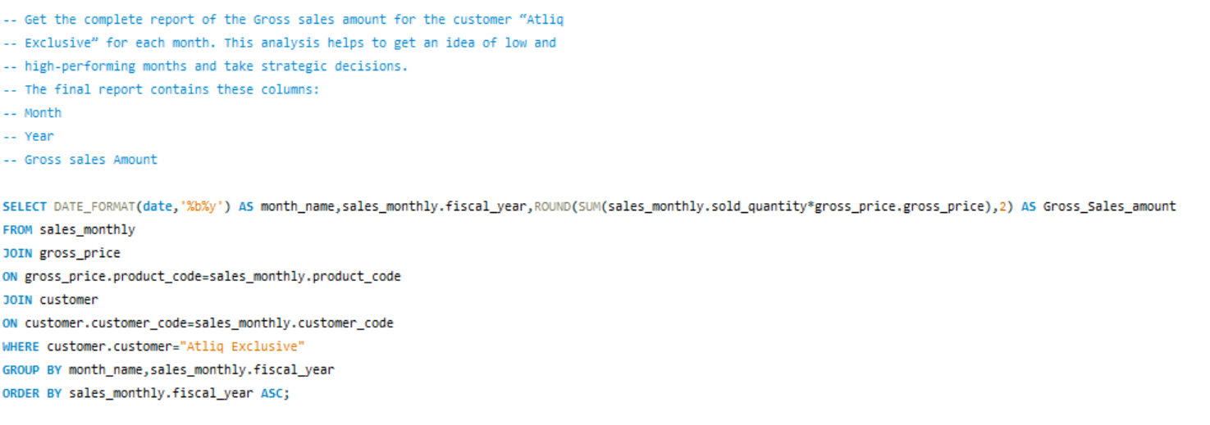
Get the complete report of the Gross sales amount for the customer “Atliq
Exclusive” for each month. This analysis helps to get an idea of low and
high-performing months and take strategic decisions.
The final report contains these columns:
Month
Year
Gross sales Amount

Slide 17
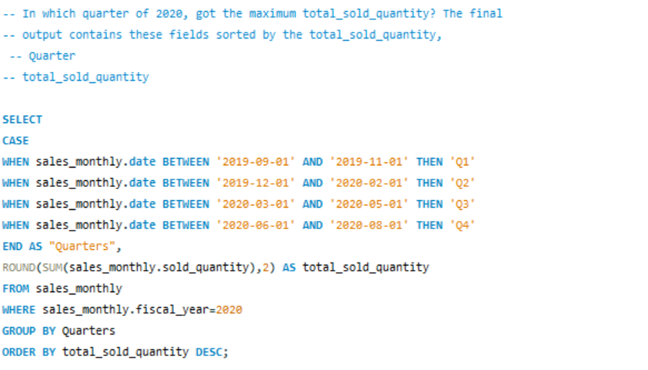
In which quarter of 2020, got the maximum total_sold_quantity? The final
output contains these fields sorted by the total_sold_quantity,
Quarter
total_sold_quantity

Slide 19
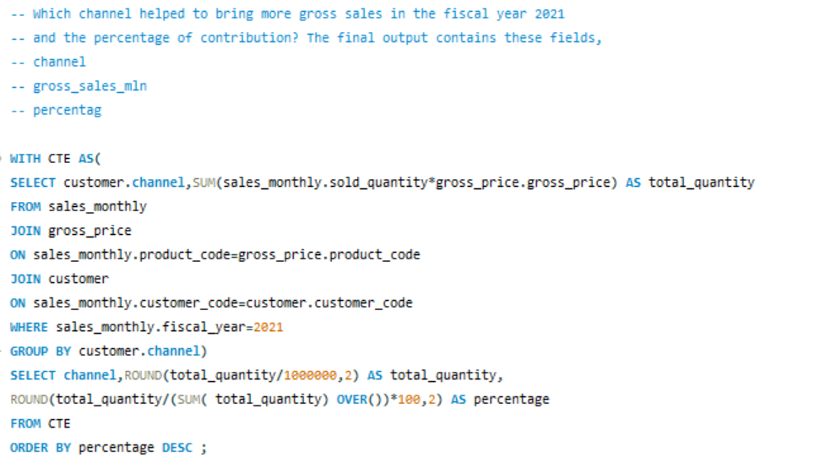
Which channel helped to bring more gross sales in the fiscal year 2021
and the percentage of contribution? The final output contains these fields,
channel
gross_sales_mln
percentage

